Slide 1

TA201T: Introduction to Manufacturing Processes I
2020-21 Semester I
TERM PAPER
TOPIC NAME: BEARING BALLS
Name: Bidhan Arya
Roll No.: 190238
Section : S-2
Tutor: Navindra S Shakunt
Instructor: Dr. Anish Upadhyaya

Slide 2
Outline
PART 1
Introduction
Literature review
Material selection
PART 2
Manufacturing process

Slide 3
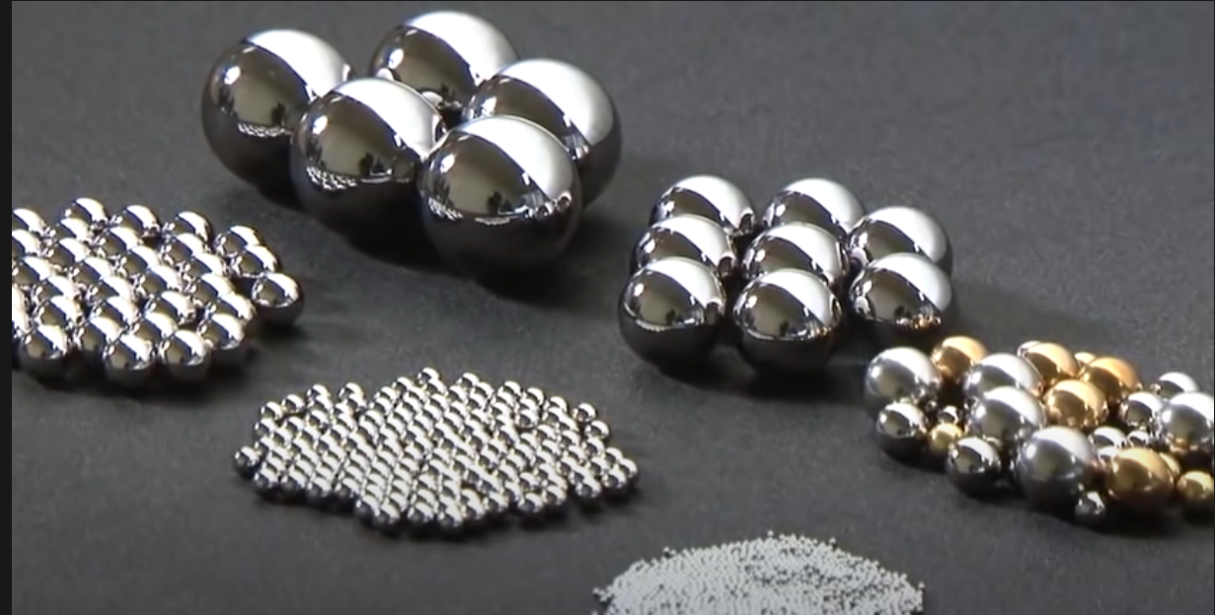
PART 1

Slide 4
Introduction
Ball bearings are one of the most basic yet most useful devices. They are used nearly everywhere, to reduce friction. They do so by reducing the area in contact between parts. Ball bearings carry types of load in a radial direction, and these loads apply a perpendicular force to the axis of rotation of the ball bearing.
Ball bearings can be of two types:
Double row ball bearings
Angular contact type ball bearings
Majority of bearings are made of chrome steel, but other materials are used to better their performance. The most common material used for bearing races is SAE 52100 steel. SAE 52100 is a chrome steel (1% carbon, 1.5% chrome alloy). Other materials which are used are AISI 52100 steel, AISI 440C stainless, other types of stainless materials, ceramics, glass or plastic.
Hybrid rolling bearings using ceramics are used in many places and bearing grade silicon nitride, Si₃N₄, is the current standard material for rolling bearings.

Slide 5
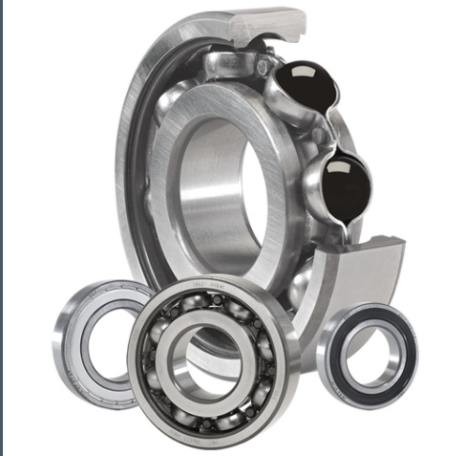
Literature Review
The latest innovation to the ball bearings are the introduction of “Hybrid ceramic ball bearings”.
Some benefits of these bearings over the older ones are as follows:
Prevent electricity arcing
Lower maintenance cost
Better service life
Extends grease life
Reduce wear due to vibrations
Lower operating temperatures
Reduce wear from contamination
Available in multiple sizes.

Slide 6
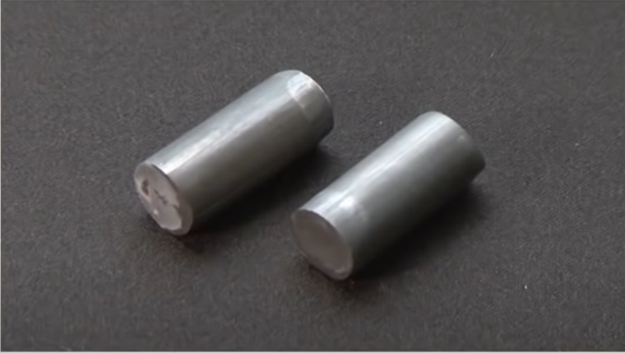
PART 2
Manufacturing Process
Balls are made from wire rods as starting material and these wire rods are cut into smaller pieces of particular size.
These small billets are then formed into balls by Impression Die forging.
This leaves the balls with burrs, and these is called “raw balls”.

Slide 7
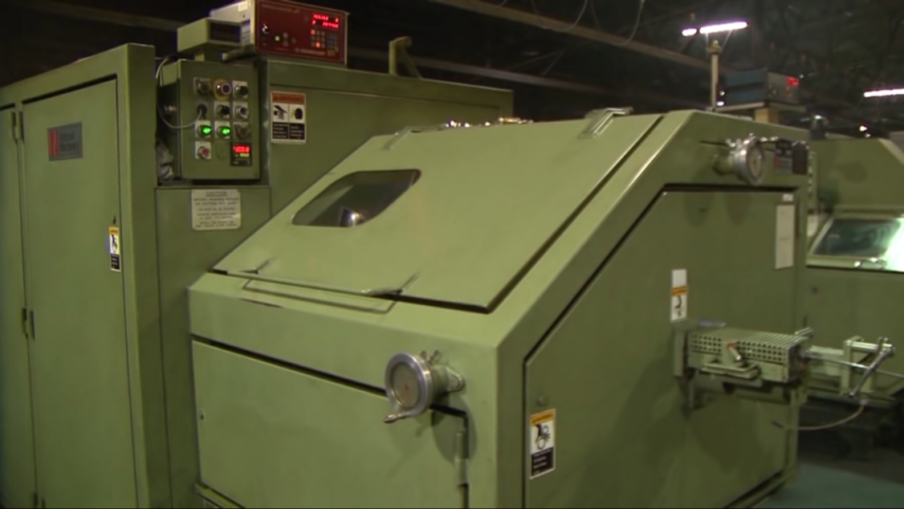
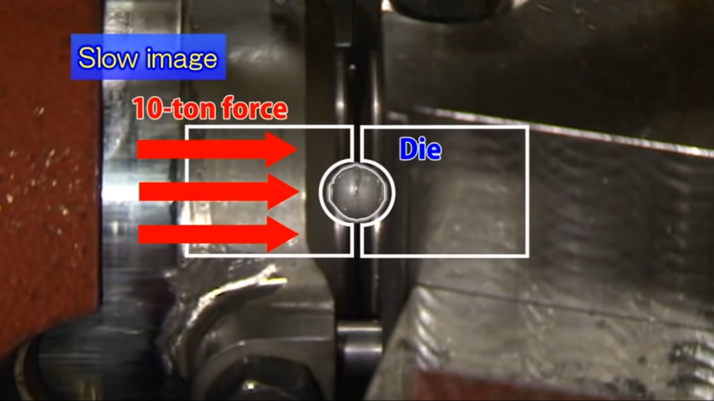
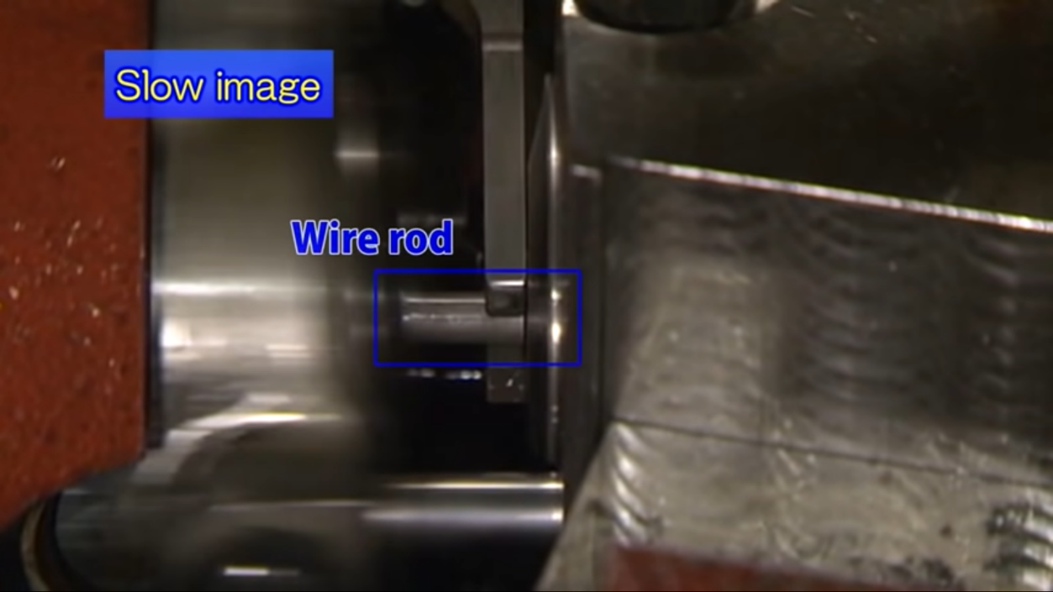
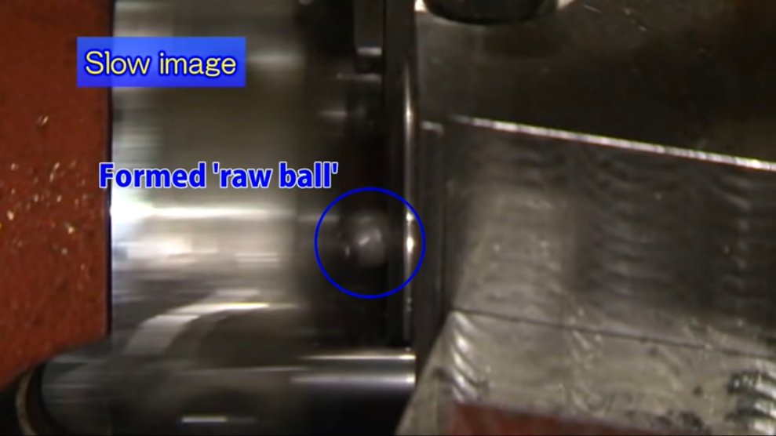
This machine presses the small billets with a force of about 10 tons.
This presses the cylindrical billet into spherical shape.
A large wire heading Machine

Slide 8
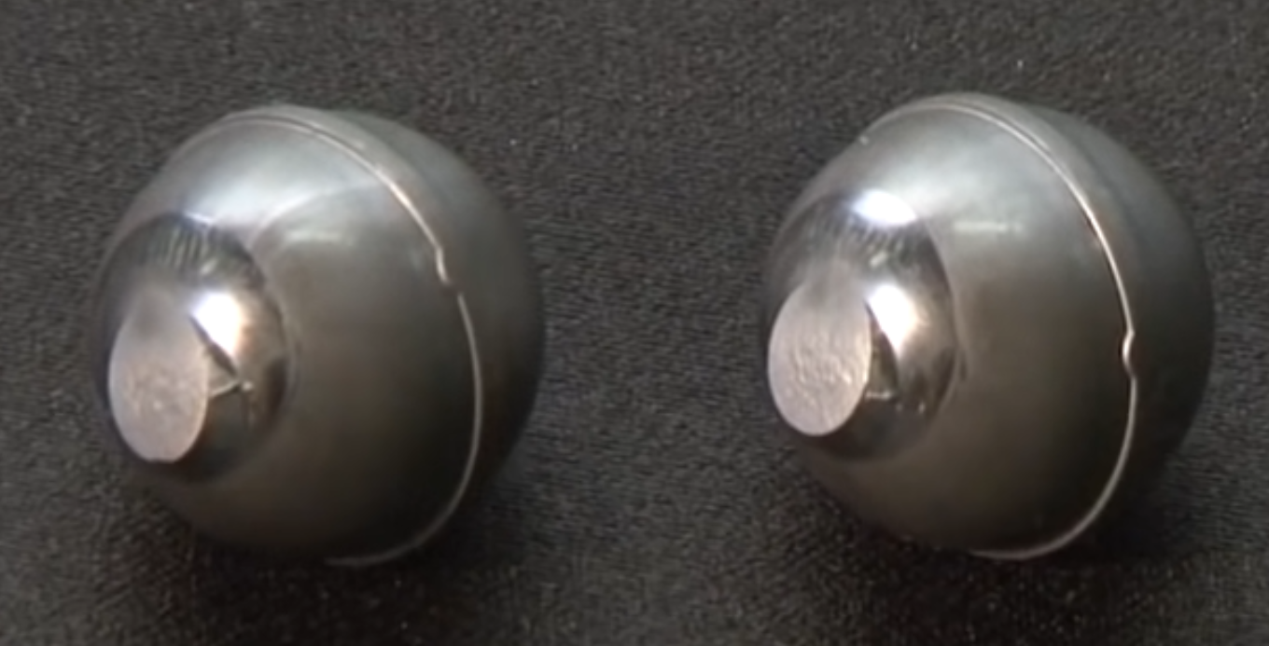
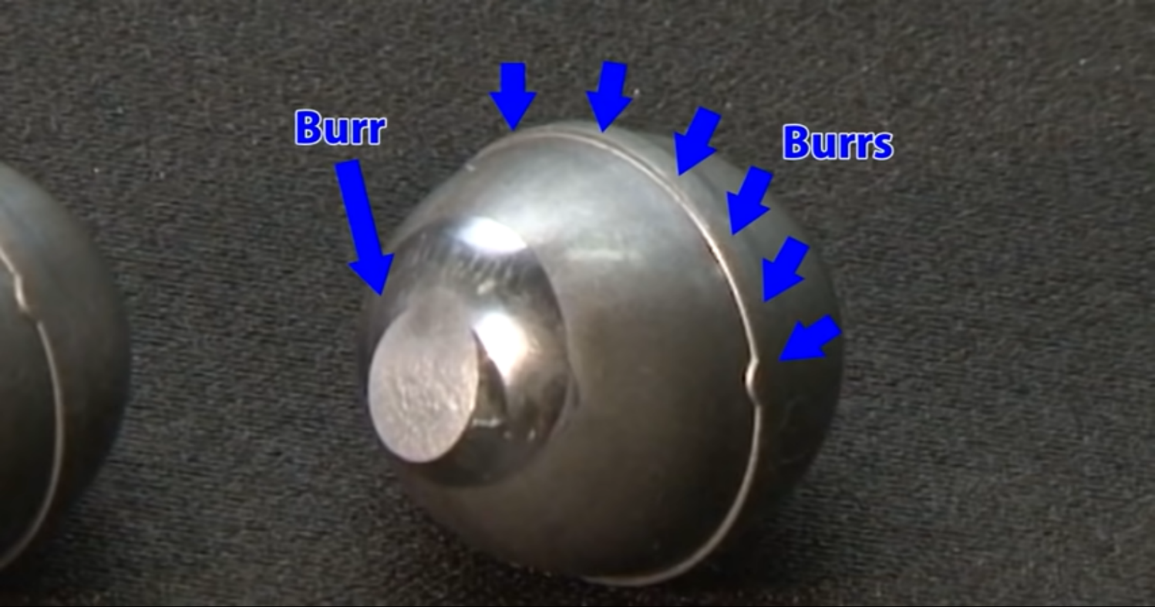
This step leaves the cylindrical billets in spherical form, which are called “raw balls”. These raw balls have burrs on them, which need to be removed in order to make them useful.

Slide 9
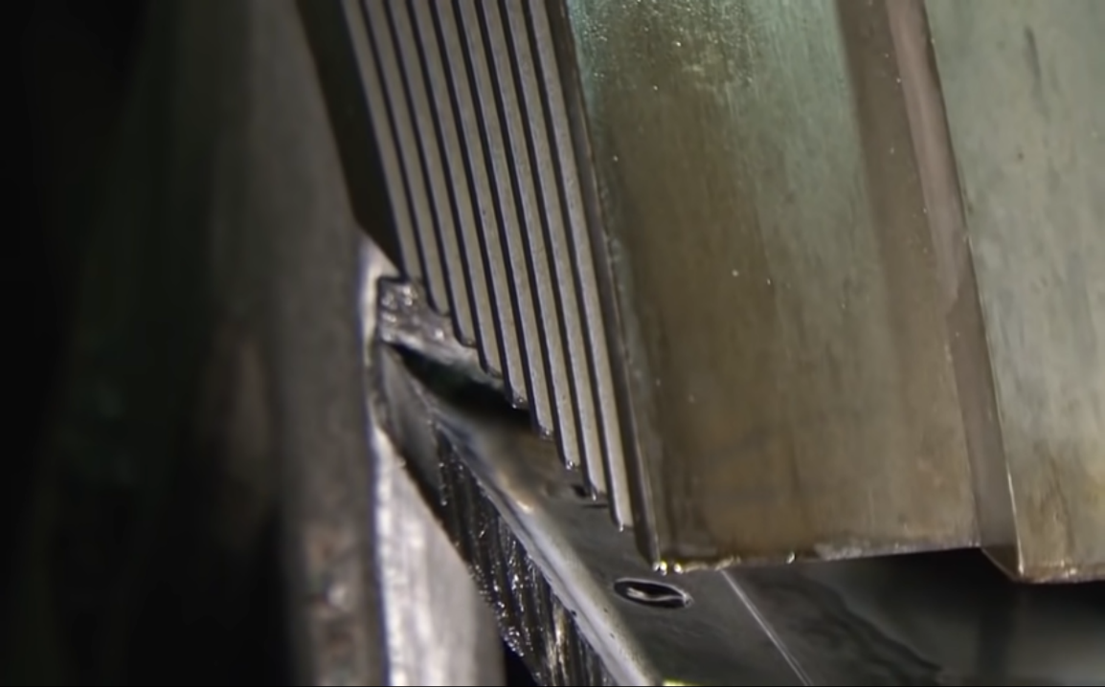
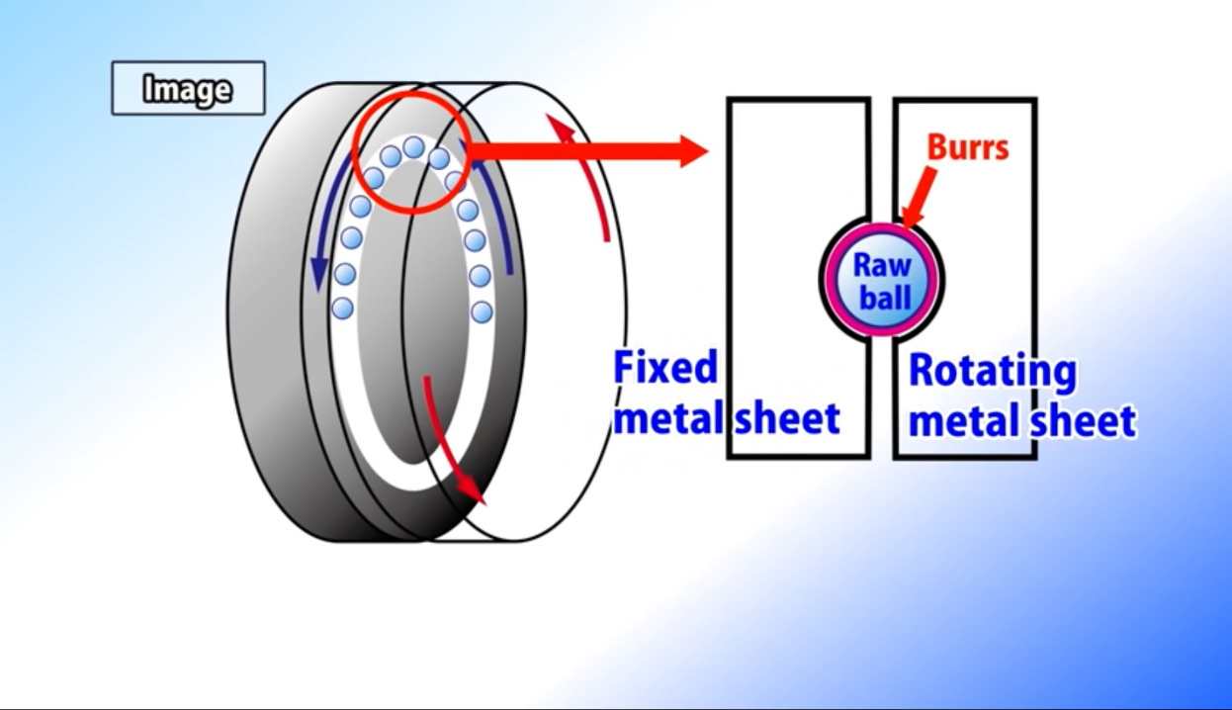
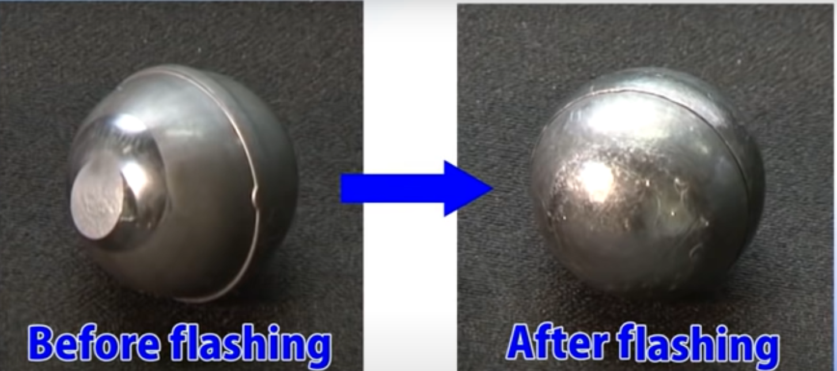
These balls then undergo a process called flashing. Flashing is used to even the surface.
The flashing machine has grooves, through which theses raw balls are passed, which makes them smooth.

Slide 10
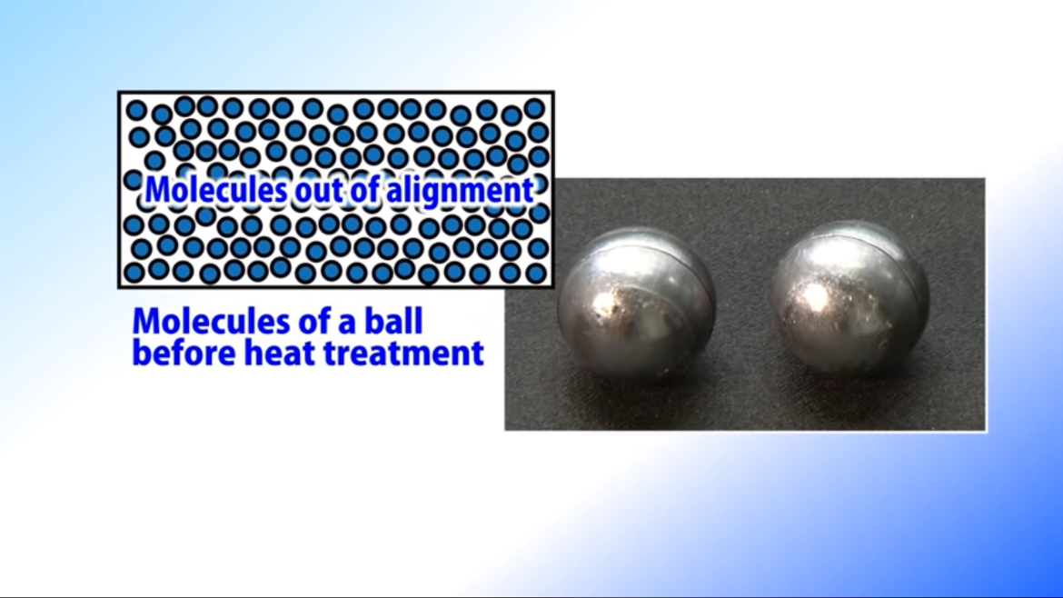
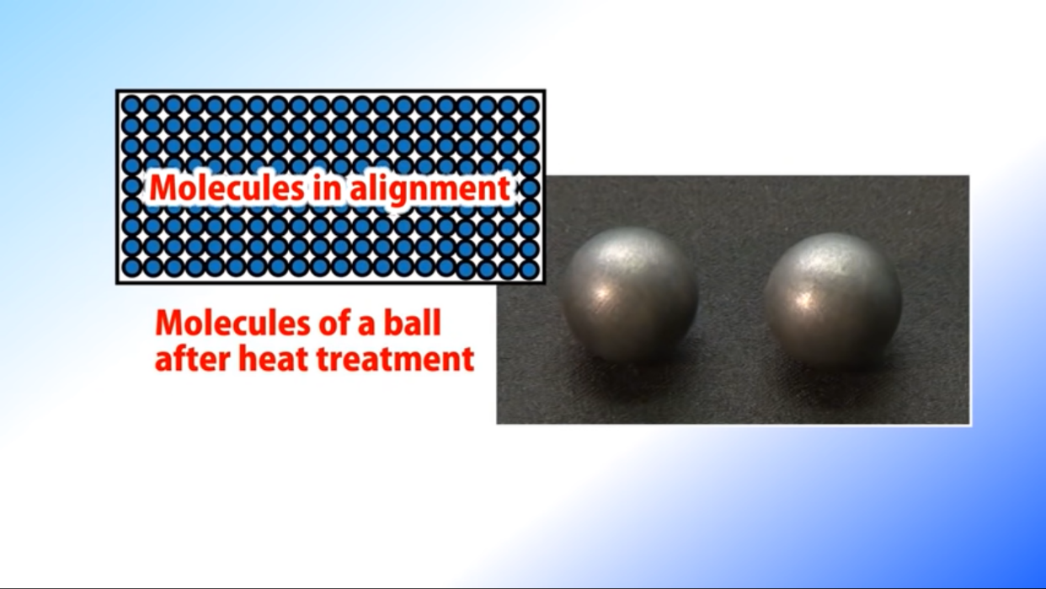
These ball bearings must withstand extreme forces, and so their strength needs to be increased . For this, it is heat treated.
The balls are first heated to about 810 degree Celsius and then quenched to 60 degree Celsius. To prevent breaking of the ball, oil is used instead of water to cool it down.
The balls are then again heated to 170 degree Celsius.
Due to this heat treatment, the molecular structure of balls become ordered and the balls become stronger.

Slide 11
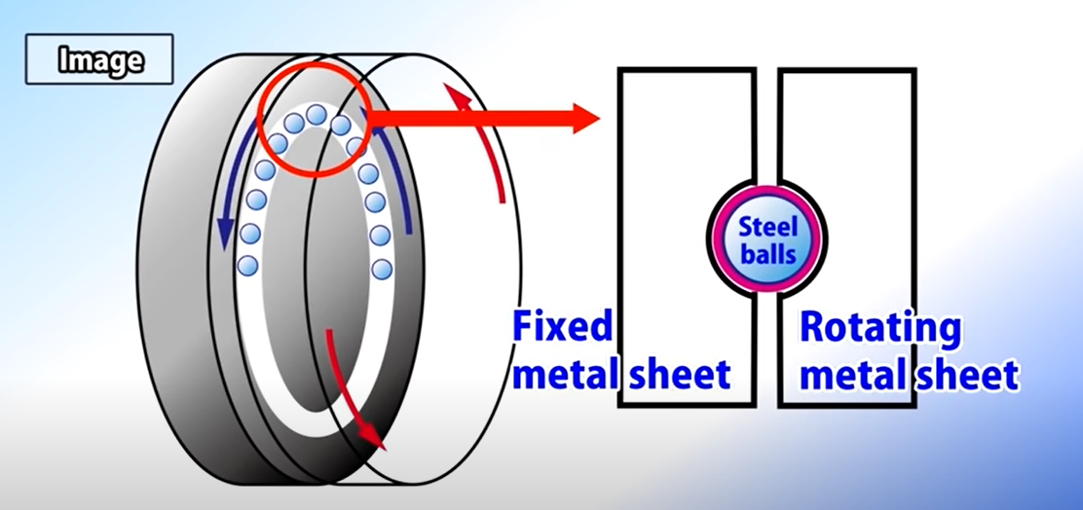
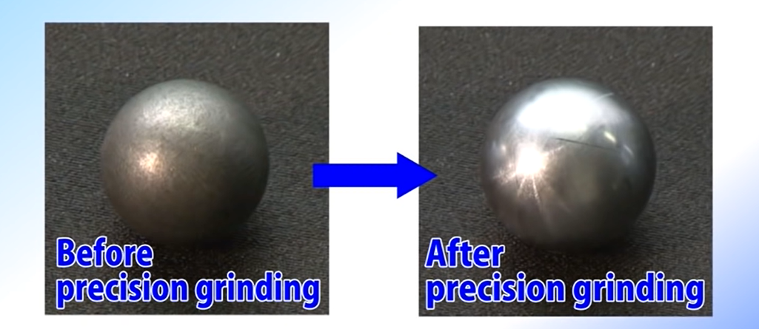
After this the ball undergoes precision grinding. This machine grinds the ball to make them nearly spherical and correct their size.
Just like in flashing, as the balls pass through the metal grooves, the surface is ground.
After precision grinding, the balls are almost completely spherical.

Slide 12
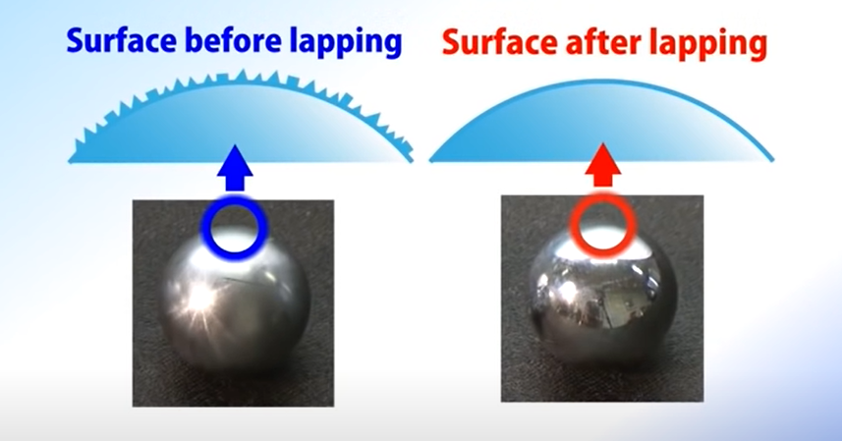
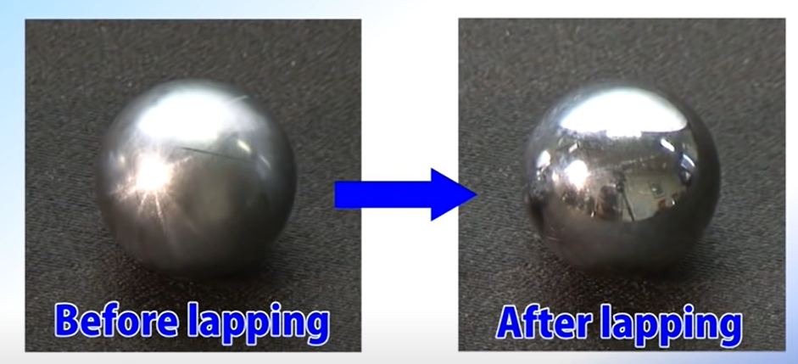
The balls are further grinded to polish the surface further. This process is called “lapping”. This process removes any unevenness of the surface and makes the ball closer to being spherical.

Slide 13
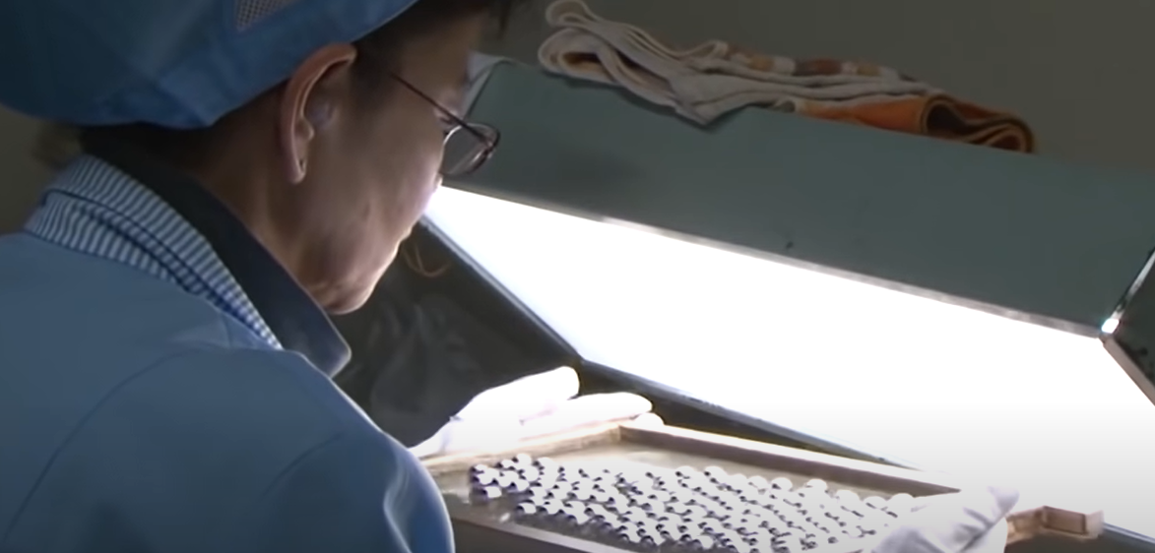
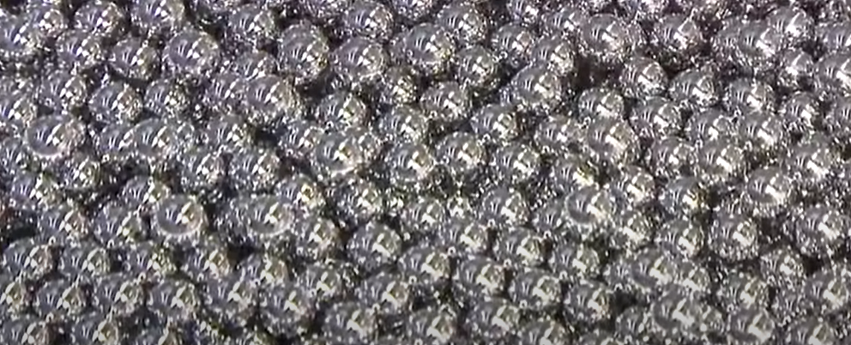
After these, the balls are moved to washing and inspection.
For inspection, machines as well as human beings are used.
Humans inspects the ball’s perfection by the way it reflects light.
The final balls are very shiny and reflect like a mirror

Slide 14
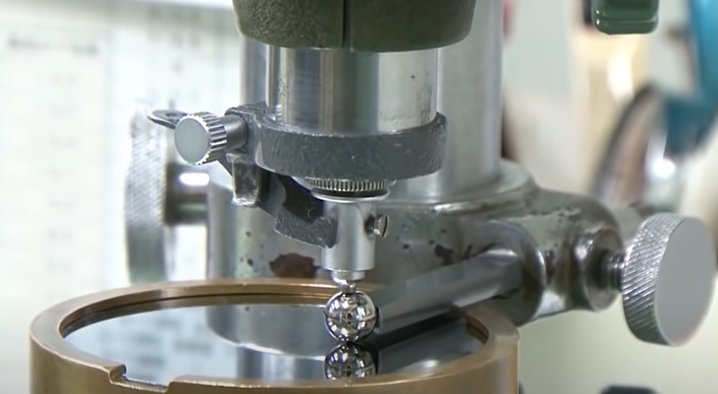
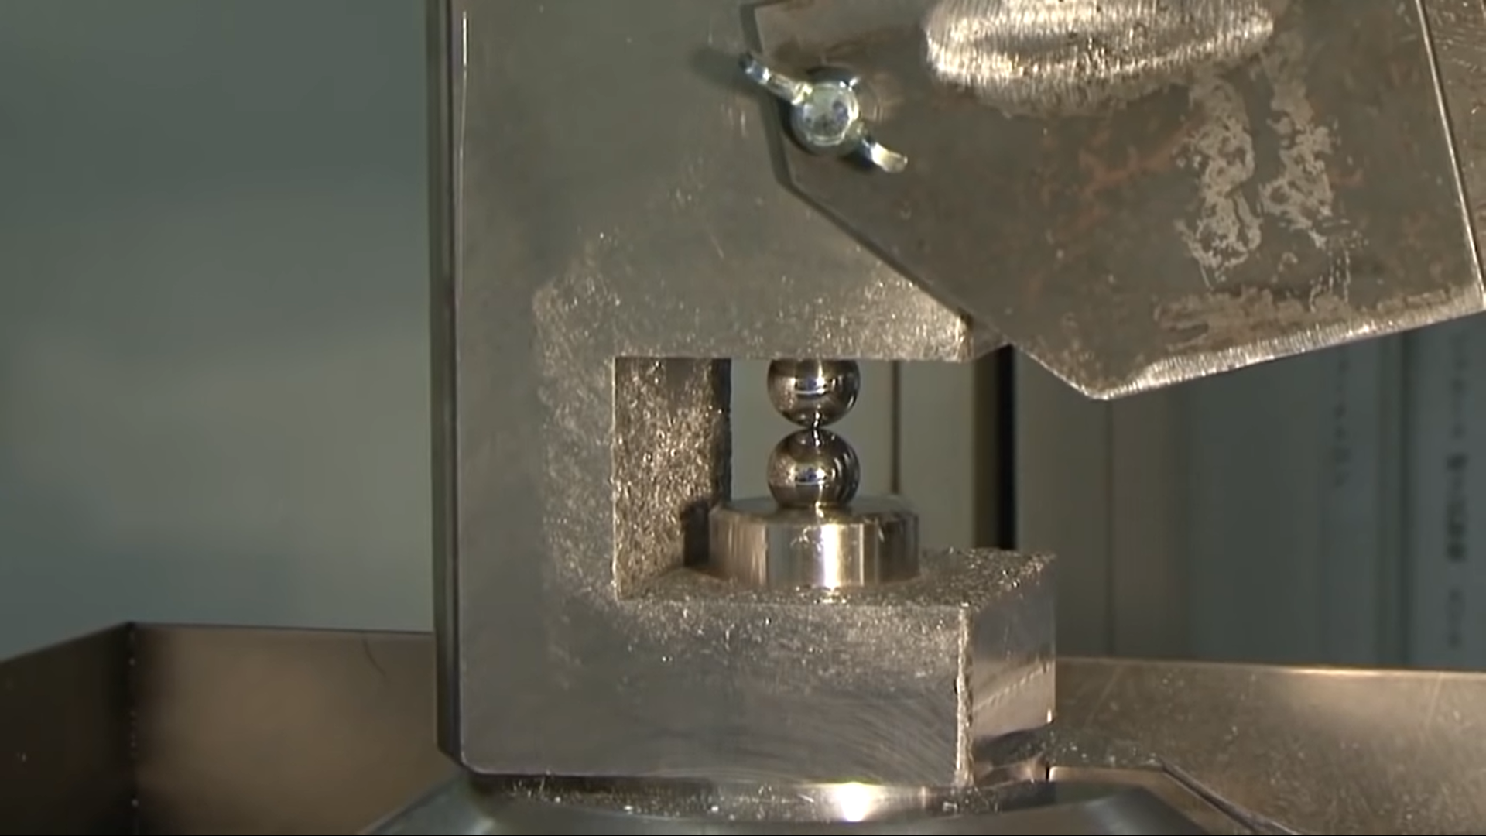
The margin of error of these balls are
now less than 0.1 micrometers
These balls, which are about 16mm in diameter, can withstand a weight of 35 tons.

Slide 15
References
https://sciencing.com/purpose-coil-springs-7637830.html
https://insights.globalspec.com/article/4523/how-ball-bearings-are-manufactured
https://www.youtube.com/watch?v=19duYMdiXi0
https://evolution.skf.com/us/developments-in-ceramic-bearing-balls/
https://www.skf.com/us/products/mrc/hybrid-ceramic-ball-bearings

